Slide 1
Chi-square
+ practice
18
Probability
and
Statistics
COMS10011
Dr. Anne Roudaut
csxar@bristol.ac.uk
https://github.com/coms10011

Slide 2
scale independent variable
What type of data?
categorical independent variable
scale dependent variable
categorical dependent variable
scale dependent variable
categorical dependent variable
regressions
Logistic
regressions
normally distributed
skewed
2 grp
>2 grp
2 grp
>2 grp
2 grp
>2 grp
Non paired
paired
Non paired
paired
Non paired
paired
Non paired
paired
Counts >= 5 in >= 75% cells
Counts >= 5 in < 75% cells
T-test
ANOVA
Mann-Whitney Utest
Wilcoxon signed rank test
Kruskall-Wallis test
Chi-square test
Fisher’s exact test
Chi-square test
Paired-t-test
Friiedman test
McNemar’s test

Slide 3
until now, we did statistical test using means or medians but the assumptions for means have eliminated certain types of variables (e.g. gender)
mean not appropriate measure of central tendency for nominal (categorical type) data
Chi-square can do do!

Slide 4
there are two types of Chi-square tests:
goodness of fit test (for one variable only)
contingency table test (for two variables at a time)

Slide 5
goodness of fit

Slide 6
looks to see if a single variable fits some hypothesised probability distribution
e.g. in a population of students, there would be an equal number of students who like or dislike brussels sprouts
in fact we don’t even have to go 50/50, we may theorize that only 1/4 (25%) will like them (because they are disgusting!)

Slide 7
# of persons
like BP 11
Dislike BP 139
150 (total)

Slide 8
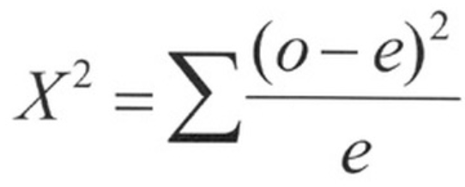
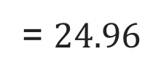
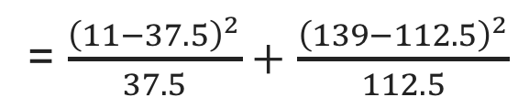
# of persons %expected # expected
like BP 11 25% 37.5 (25% of 150)
Dislike BP 139 75% 112.5 (75% of 150)
150 (total) 100% 150 (total)
observed cases
expected cases
= $\frac{{\left(11−37.5\right)}^{2}}{37.5}+$ $\frac{{\left(139−112.5\right)}^{2}}{112.5}$
= $24.96$

Slide 9
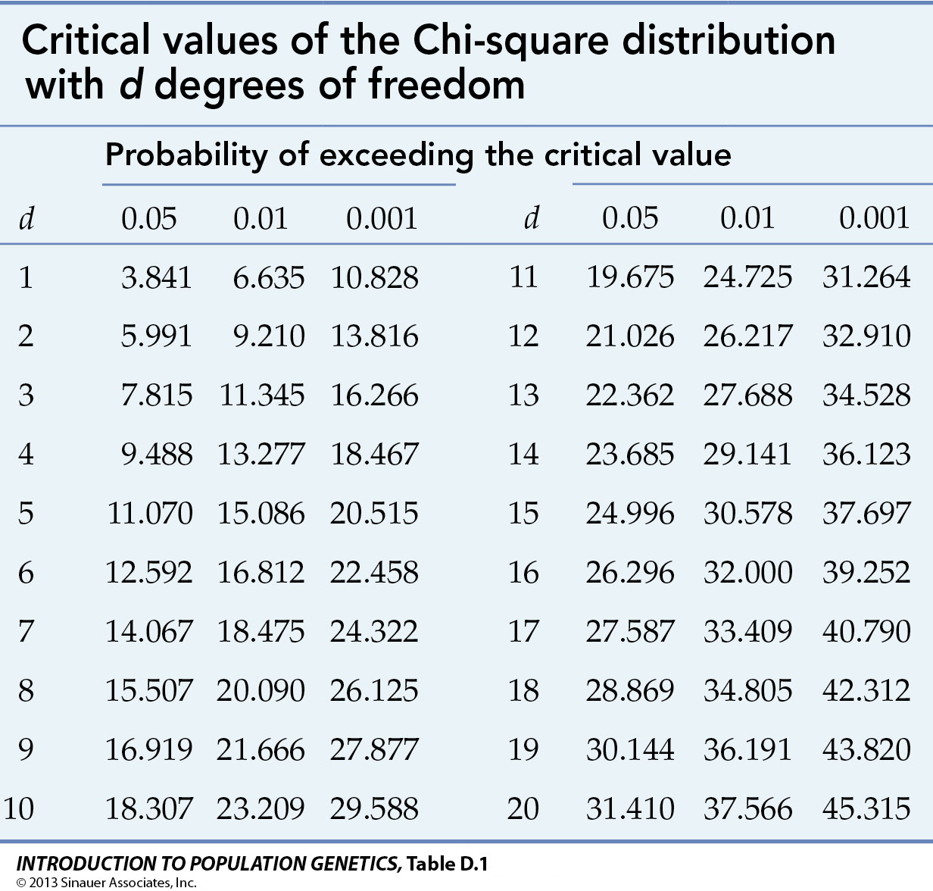
now, like with all the test we have seen, we look into a table, here the Chi-square table)
degree of freedom DF
= number of group - 1

Slide 10
24.96 > 3.841 so we reject the null hypothesis
our theory of 25% Brussel Sprout lovers does not hold

Slide 11
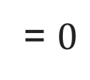
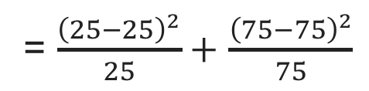
# of persons %expected # expected
like BP 25 25% 25 (25% of 100)
Dislike BP 75 75% 75 (75% of 100)
100 (total) 100% 100 (total)
observed cases
expected cases
= $\frac{{\left(25−25\right)}^{2}}{25}+$ $\frac{{\left(75−75\right)}^{2}}{75}$
= $0$
if data was perfect fit (pvalue would be = 1) … cannot reject null (thus cannot conclude)

Slide 12
let’s see if our theory holds with a raise of hand
who like Brussel sprout?
who dislike Brussel sprout?

Slide 13
R
table = c(11,139)
chisq.test(tulip, p = c(1/4, 3/4))
Chi-squared test for given probabilities
data: table
X-squared = 24.969, df = 1, p-value = 5.826e-07

Slide 14
this example is fairly simple but Chi-square also work with more data, e.g. 30% prefer eating chicken for Christmas dinner, 50% prefer turkey, 10% prefer vegetarian option, 10% prefer other types of meat

Slide 15
contingency tables

Slide 16
public opinion surveys tend to show there is a relationship between gender and something, e.g. preference in sport car vs. family car (public opinion surveys are very stereotypical!)
so here we have two variables/groups: gender (female or male) and car preference (sport or family)
we do a Chi-square contingency table test to prove preference of car is related to or dependant upon gender
male female
sport 26 3
family 24 22

Slide 17
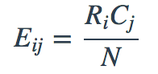
but we don’t have ”expected value” here so we first need to calculate them for each cell
where R = row, C= column, N = total,
for ith row and jth column

Slide 18
male female Sum
sport 26 3 29
family 24 22 46
Sum 50 25 75
1. we compute the sums in all direction
2. for each cell, multiplying that cells row and column totals and dividing by our total sample size
e.g. case (sport, male)= (29 * 50) / 75
e.g. case (family, male= (46 * 50) / 75
…

Slide 19
Obs. male female
sport 26 3
family 24 22
Exp. male female
sport 19.3 0.9
family 30.6 15.3
4. use same Chi-square formula than before
5. Calculate degree of freedom as DF =(number of rows−1)∗(number of columns−1) (here = 1)
6. Use the Chi-square table to conclude!
Notes:
pchisq(0.43, df=2, lower.tail = FALSE)

Slide 20
R
table = matrix(c(26, 24, 3, 22), ncol=2)
colnames(table) = c('male', 'female')
rownames(table) = c('sport','family’)
addmargins(table)
male female Sum
sport 26 3 29
family 24 22 46
Sum 50 25 75
chisq.test(table,correct=FALSE) #must use correct=FALSE for a 2 by 2 table otherwise = TRUE
Pearson's Chi-squared test
data: table
X-squared = 11.244, df = 1, p-value = 0.0007986

Slide 21
we reject the null and conclude that car type preference is dependant of gender

Slide 22
extra R

Slide 23
2 grp
>2 grp
Non paired
paired
Counts >= 5 in >= 75% cells
Counts >= 5 in < 75% cells
Chi-square test
Fisher’s exact test
Chi-square test
McNemar’s test

Slide 24
R
Fisher
> library(MASS) # load the MASS package > tbl = table(survey$Smoke, survey$Exer)
> tbl # the contingency table Freq None Some Heavy 7 1 3 Never 87 18 84 Occas 12 3 4 Regul 9 1 7
fisher.test(tbl) # if Counts >= 5 in < 75% cells otherwise or chisq.test(tbl)
Fisher's Exact Test for Count Data
data: tbl
p-value = 0.4138
alternative hypothesis: two.sided
Notes:
head(cars) # cars is a table that already comes with R and contain 50 observations of speed and distance in two rows
scatter.smooth(x=cars$speed, y=cars$dist, main="Dist ~ Speed") # scatterplot
linearMod <- lm(dist ~ speed, data=cars) # build linear regression model on full data
summary(linearMod) # summary(linearMod)$r.squared
abline(linearMod, col="blue")

Slide 25
R
mcnemar
# mcnemar example on presidential Approval Ratings: Approval of the President's performance in office in two surveys, one month apart, for a random sample of 1600 voting-age Americans.
Performance <- matrix(c(794, 86, 150, 570), nrow = 2, dimnames = list("1st Survey" = c("Approve", "Disapprove"), "2nd Survey" = c("Approve", "Disapprove")))
Performance
2nd Survey
1st Survey Approve Disapprove
Approve 794 150
Disapprove 86 570
mcnemar.test(Performance)
Notes:
head(cars) # cars is a table that already comes with R and contain 50 observations of speed and distance in two rows
scatter.smooth(x=cars$speed, y=cars$dist, main="Dist ~ Speed") # scatterplot
linearMod <- lm(dist ~ speed, data=cars) # build linear regression model on full data
summary(linearMod) # summary(linearMod)$r.squared
abline(linearMod, col="blue")

Slide 26
pre-summary

Slide 27
ok so now you know almost all the tests needed!

Slide 28
scale independent variable
What type of data?
categorical independent variable
scale dependent variable
categorical dependent variable
scale dependent variable
categorical dependent variable
regressions
Logistic
regressions
normally distributed
skewed
2 grp
>2 grp
2 grp
>2 grp
2 grp
>2 grp
Non paired
paired
Non paired
paired
Non paired
paired
Non paired
paired
Counts >= 5 in >= 75% cells
Counts >= 5 in < 75% cells
T-test
ANOVA
Mann-Whitney Utest
Wilcoxon signed rank test
Kruskall-Wallis test
Chi-square test
Fisher’s exact test
Chi-square test
Paired-t-test
Friiedman test
McNemar’s test

Slide 29
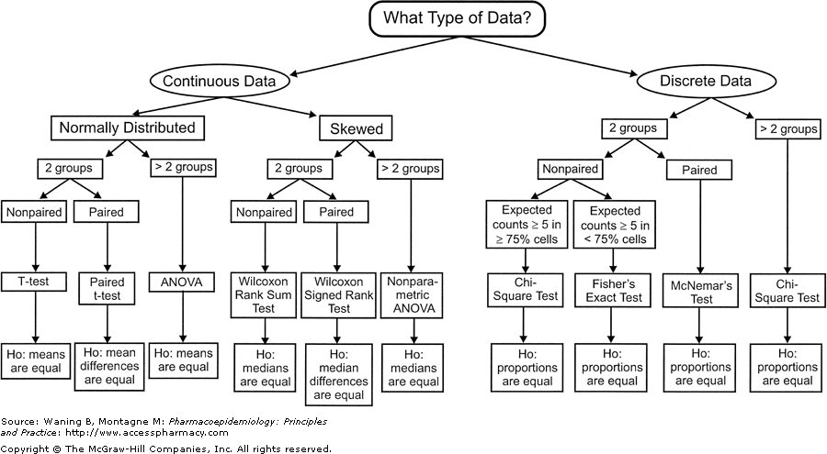
scale independent variable
What type of data?
categorical independent variable
scale dependent variable
categorical dependent variable
scale dependent variable
categorical dependent variable
regressions
logistic
regressions
normally distributed
skewed
2 grp
>2 grp
2 grp
>2 grp
2 grp
>2 grp
Non paired
paired
Non paired
paired
Non paired
paired
Non paired
paired
Counts >= 5 in >= 75% cells
Counts >= 5 in < 75% cells
T-test
ANOVA
Mann-Whitney Utest
Wilcoxon signed rank test
Kruskall-Wallis test
Chi-square test
Fisher’s exact test
Chi-square test
Paired-t-test
Friiedman test
McNemar’s test

Slide 30
the most important is not that you do these by hands but that you understand the intuition behind them and more importantly when to use them

Slide 31
practice

Slide 32
Condition 1
Metrics (most
often only 1)
Condition 2
...
measure
Condition n
do

Slide 33
nature of this
(independent variables)
Condition 1
nature of this
(dependent ones)
Metrics (most
often only 1)
Condition 2
...
measure
Condition n
do

Slide 34
scale independent variable
What type of data?
categorical independent variable
Condition 1
Continuous IV?
Or discrete IV?
Size of targets users point at
Weight of users
Amount of chocolate eaten
Condition 2
...
Chocolate vs. not vs. punishment
Condition n
Gender
Milk before or after
do

Slide 35
scale independent variable
What type of data?
caterorical independent variable
Condition 1
Continuous IV?
Or discrete IV?
Size of targets users point at
Weight of users
Amount of chocolate eaten
Condition 2
...
Chocolate vs. not vs. punishment
Condition n
Gender
Milk before or after
do

Slide 36
scale independent variable
What type of data?
categorical independent variable
scale dependent variable
categorical dependent variable
regressions
Logistic
regressions

Slide 37
scale independent variable
What type of data?
categorical independent variable
Condition 1
Continuous IV?
Or discrete IV?
Size of targets users point at
Weight of users
Amount of chocolate eaten
Condition 2
...
Chocolate vs. not vs. punishment
Condition n
Gender
Milk before or after
do

Slide 38
scale independent variable
What type of data?
categorical independent variable
scale dependent variable
categorical dependent variable

Slide 39
scale independent variable
What type of data?
categorical independent variable
scale dependent variable
categorical dependent variable
Metrics (most
often only 1)
measure

Slide 40
scale independent variable
What type of data?
categorical independent variable
scale dependent variable
categorical dependent variable
Continuous DV?
Or discrete DV?
Memorization score
Metrics (most
often only 1)
Time or errors
Liker scale answers (special case!)
measure
Yes No answer
Preference between X categories
Gender

Slide 41
scale independent variable
What type of data?
categorical independent variable
scale dependent variable
categorical dependent variable
2 grp
>2 grp
Non paired
paired
Counts >= 5 in >= 75% cells
Counts >= 5 in < 75% cells
Chi-square test
Fisher’s exact test
Chi-square test
McNemar’s test

Slide 42
scale independent variable
What type of data?
categorical independent variable
scale dependent variable
categorical dependent variable
normally distributed
skewed
2 grp
>2 grp
2 grp
>2 grp
Non paired
paired
Non paired
paired
Non paired
paired
T-test
ANOVA
Mann-Whitney Utest
Wilcoxon signed rank test
Kruskall-Wallis test
Paired-t-test
Friiedman test

Slide 43
scale independent variable
What type of data?
categorical independent variable
scale dependent variable
categorical dependent variable
scale dependent variable
categorical dependent variable
regressions
Logistic
regressions
normally distributed
skewed
2 grp
>2 grp
2 grp
>2 grp
2 grp
>2 grp
Non paired
paired
Non paired
paired
Non paired
paired
Non paired
paired
Counts >= 5 in >= 75% cells
Counts >= 5 in < 75% cells
T-test
ANOVA
Mann-Whitney Utest
Wilcoxon signed rank test
Kruskall-Wallis test
Chi-square test
Fisher’s exact test
Chi-square test
Paired-t-test
Friiedman test
McNemar’s test

Slide 44
recognising data types

Slide 46


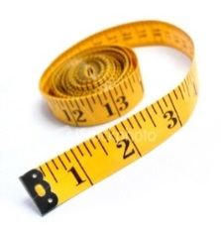


Slide 47
Q1: What is your favourite subject?
Q2: Gender:
Q3: I consider myself to be good at mathematics:
Q4: Score in a recent mock GCSE maths exam:
Maths | English | Science | Art | French
Male | Female
Strongly Disagree | Disagree | Not Sure | Agree | Strongly Agree
Score between 0% and 100%

Slide 48
Categorical / Nominal
Q1: What is your favourite subject?
Q2: Gender:
Q3: I consider myself to be good at mathematics:
Q4: Score in a recent mock GCSE maths exam:
Maths | English | Science | Art | French
Male | Female
Categorical / Nominal (binary)
Strongly Disagree | Disagree | Not Sure | Agree | Strongly Agree
Categorical / Ordinal
Score between 0% and 100%
Scale

Slide 49
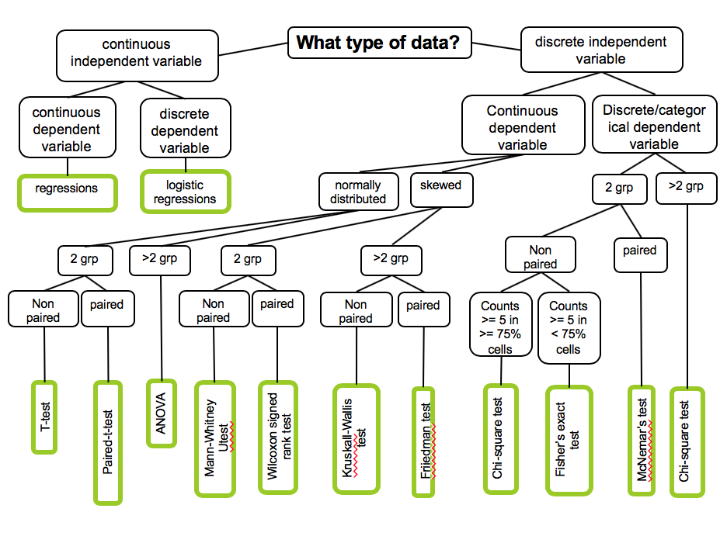
Likert can be treated as continuous

Slide 50
summary

Slide 51
take away
Be able to give the CHI-square formula (goodness of fit and contingency table)
Calculate a CHI-square by hand on an example with a single variable and conclude
Explain what is the different between goodness of fit and contingency table methods
Be able to navigate the mother of all stats graph! = know how to identify a variable type and choose appropriate test

Slide 52
take away
in the exam the only calculations I could make you do are linear regression or chi square
you don’t need to learn the formula for all the other statistic tests

Slide 53
unit menu
Linear regression
Hypothesis testing, comparing things
Experimental design part 1
Experimental design part 2
T-test and ANOVA
Pre-requisite to ANOVA
Non-parametric tests
Categorical data: Chi-square
Sample size, power and effect size (guest)
P-hacking and alternatives tests (guest)

Slide 54
end

